Slide 1
Complex Geometry
Transformations and Loci

Slide 2
Transformations
Last time, we looked at rotation of regular polygons, and how to combine them in weird and wonderful ways.
Now we’re going to look at general complex functions, and how to transform them in other ways.

Slide 3
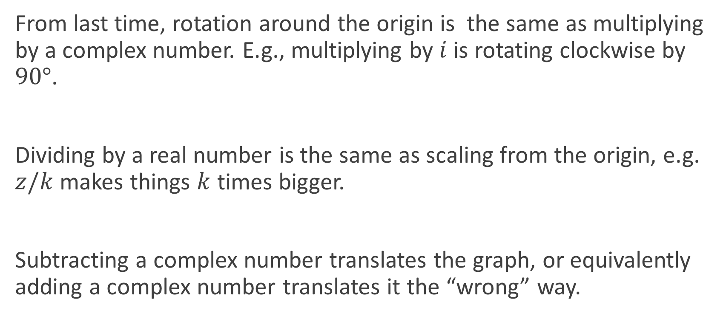
The key points
From last time, rotation around the origin is the same as multiplying by a complex number. E.g., multiplying by $i$ is rotating clockwise by $90°$.
Dividing by a real number is the same as scaling from the origin, e.g. $z/k$ makes things $k$ times bigger.
Subtracting a complex number translates the graph, or equivalently adding a complex number translates it the “wrong” way.

Slide 4

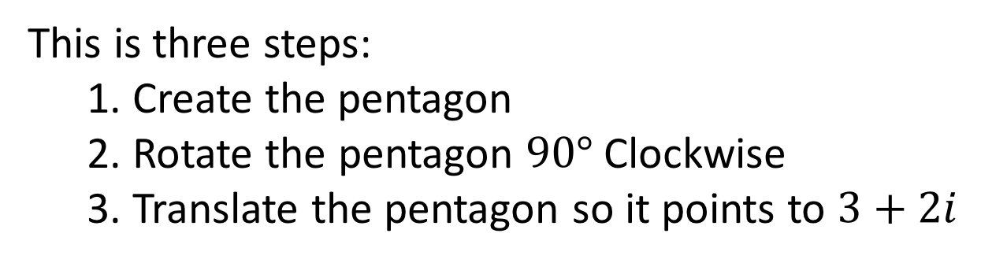
Example
Take a unitary regular complex polygon, and transform it so it is pointing down onto $3+2i$.
This is three steps:
1. Create the pentagon
2. Rotate the pentagon $90°$ Clockwise
3. Translate the pentagon so it points to $3+2i$

Slide 5

Example
Take a unitary regular complex polygon, and transform it so it is pointing down onto $3+2i$.
1. Create the pentagon
$$z^{5}−1=0$$

Slide 6
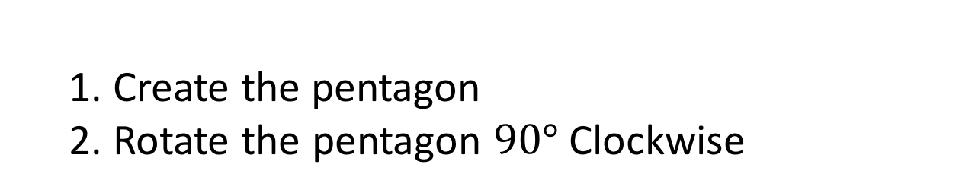


Example
Take a unitary regular complex polygon, and transform it so it is pointing down onto $3+2i$.
1. Create the pentagon
2. Rotate the pentagon $90°$ Clockwise
$${(z⋅i)}^{5}−1=0$$
$$z^{5}i−1=0$$

Slide 7
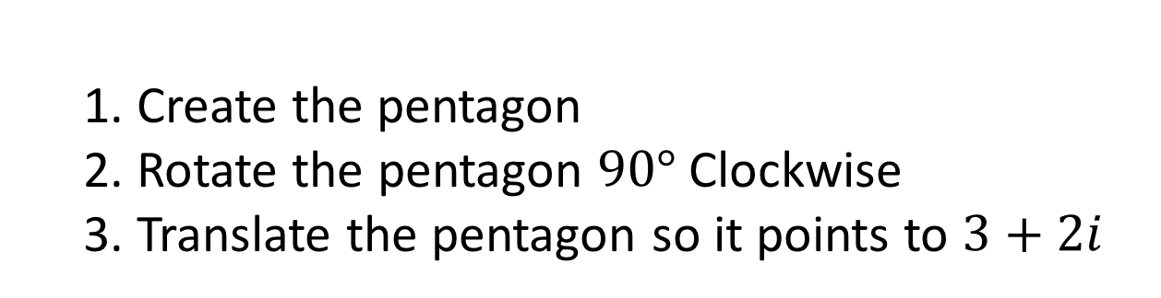


Example
Take a unitary regular complex polygon, and transform it so it is pointing down onto $3+2i$.
1. Create the pentagon
2. Rotate the pentagon $90°$ Clockwise
3. Translate the pentagon so it points to $3+2i$
Translate center to $3+3i$:
$${(z−(3+3i))}^{5}i−1=0$$

Slide 8
Complex Loci
Complex numbers exist in two dimensions, meaning that when we place restrictions upon their location, we can draw curves or areas.
There are two key ideas: writing an equation from a description, and working out the description from an equation.
The first part is all about conics, the second is algebraic.

Slide 9


Example 1
A point $P=(x,y)$ is 3 units away from $(3, −4)$. Describe $P$.
This definition is clearly that of a circle. The general form of a circle is
$${\left(x −a\right)}^{2}+{\left(y−b\right)}^{2}=r^{2}$$
The radius is $3$, and $(a, b)=(3, −4)$.
Thus the final equation is
$${\left(x −3\right)}^{2}+{\left(y+4\right)}^{2}=3^{2}$$

Slide 10
Example 2
A point $P=(x,y)$ is equidistant from $(−1, 4)$ and $(5, 2)$.
This is trickier, as it doesn’t match any conic that I can think of. Instead, perhaps we should start with the direct translation?
$$\left|\left(x,y\right)−\left(−1, 4\right)\right|=|\left(x,y\right)−\left(5, 2\right)|$$
$$\left|\left(x+1,y−4\right)\right|=|\left(x−5,y−2\right)|$$
$$\sqrt{{\left(x+1\right)}^{2}+{\left(y−4\right)}^{2}}=\sqrt{{\left(x−5\right)}^{2}+{\left(y−2\right)}^{2}}$$
$${\left(x+1\right)}^{2}+{\left(y−4\right)}^{2}={\left(x−5\right)}^{2}+{\left(y−2\right)}^{2}$$

Slide 11



Example 2
This is the perpendicular bisector of the line formed by the two points!
A point $P=(x,y)$ is equidistant from $(−1, 4)$ and $(5, 2)$.
$${\left(x+1\right)}^{2}+{\left(y−4\right)}^{2}={\left(x−5\right)}^{2}+{\left(y−2\right)}^{2}$$
$${\left(x+1\right)}^{2}−{\left(x−5\right)}^{2}={\left(y−2\right)}^{2}−{\left(y−4\right)}^{2}$$
$$x^{2}+2x+1−x^{2}+10x−25=y^{2}−4y+4−y^{2}+8y−16$$
$$12x −24=4y−12$$
$$3x −6=y−3$$
$$y=3x−3$$

Slide 12


Example 3
Describe the locus formed by the equation
where $z$ is a complex variable.
$$\left|z −2\right|+\left|z+2\right|>5$$
$$\left|(x+yi) −2\right|+\left|(x+yi)+2\right|>5$$
$$\left|\left(x−2\right)+yi\right|+\left|\left(x+2\right)+yi\right|>5$$
$$\sqrt{{\left(x−2\right)}^{2}+y^{2}}+\sqrt{{\left(x+2\right)}^{2}+y^{2}}>5$$
$$\sqrt{{\left(x−2\right)}^{2}+y^{2}}>5−\sqrt{{\left(x+2\right)}^{2}+y^{2}}$$

Slide 13

Example 3
$$\sqrt{{\left(x−2\right)}^{2}+y^{2}}>5−\sqrt{{\left(x+2\right)}^{2}+y^{2}}$$
$${\left(x−2\right)}^{2}+y^{2}>25−10\sqrt{{\left(x+2\right)}^{2}+y^{2}}+{\left(x+2\right)}^{2}+y^{2}$$
$${{\left(x+2\right)}^{2}−\left(x−2\right)}^{2}+25<10\sqrt{{\left(x+2\right)}^{2}+y^{2}}$$
$$x^{2}+4x+4−x^{2}+4x−4+25<10\sqrt{{\left(x+2\right)}^{2}+y^{2}}$$
$$8x+25<10\sqrt{{\left(x+2\right)}^{2}+y^{2}}$$
$${\left(8x+25\right)}^{2}<100\left({\left(x+2\right)}^{2}+y^{2}\right)$$

Slide 14

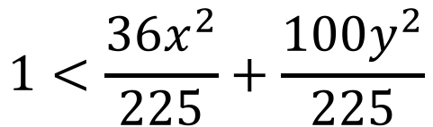
Example 3
$${\left(8x+25\right)}^{2}<100\left({\left(x+2\right)}^{2}+y^{2}\right)$$
$$64x^{2}+400x+625<100\left(x^{2}+4x+4+y^{2}\right)$$
$$64x^{2}+400x+625<100x^{2}+400x+400+100y^{2}$$
$$225<36x^{2}+100y^{2}$$
$$1<\frac{36x^{2}}{225}+\frac{100y^{2}}{225}$$

Slide 15
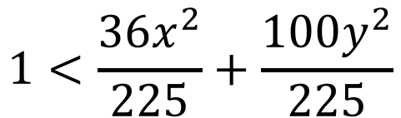
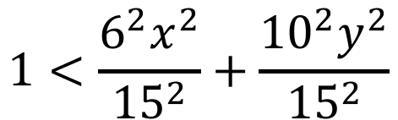
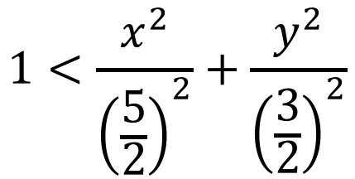

Example 3
$$1<\frac{36x^{2}}{225}+\frac{100y^{2}}{225}$$
This is the area outside an ellipse, centered on the origin, with semi-major axis length $\frac{5}{2}$ and semi-minor axis length $\frac{3}{2}$.
$$1<\frac{6^{2}x^{2}}{{15}^{2}}+\frac{{10}^{2}y^{2}}{{15}^{2}}$$
$$1<\frac{x^{2}}{{\left(\frac{5}{2}\right)}^{2}}+\frac{y^{2}}{{\left(\frac{3}{2}\right)}^{2}}$$

Slide 16
Do Now
Any Questions?
Delta Workbook
Nothing this time.
Workbook
Pages 206-209, 227-232

Slide 17

This work is licensed under a Creative Commons Attribution-NonCommercial-ShareAlike 4.0 International License.
Aaron Stockdill
2016

